Slide 1

Analysis and Insights on COVID-19 based on Twitter Tweets.
Team :- 4
Weijie Guan
Adwait Sathe
Rohan Choudhary

Slide 2
Project Goals
Analyze the dataset to figure out how people think about the coronavirus and use machine learning models to add some tags like worried, not worried to tweets.
From Technology Perspective, Learn Apache Kafka , Apache Spark and Apache Zeppelin.

Slide 3
Methodology
Data Ingestion : - Get the Tweets From Twitter related to COVID-19 (Apache Kafka)
Data Cleaning and Transformation : - Cleaned and transformed data based on features needed for analysis(Apache Spark)
Data Analysis :-Do sentimental analysis on our dataset and train a machine learning model to classify the tweets (Apache SparkML)
Data Visualization :- Based on sentimentsand Region (Databricks Notebook)

Slide 4
Architectural Structure
Data Source
Consumer
Visualization
Kafka producer
Kafka broker
Spark streaming
Sparkmllib
Zeppelin
Database

Slide 5
Data Pipeline
Raw Layer :- Ingesting Raw tweets
Optimized Layer :- After cleaning the Data
Processed Layer :- After tweets have been Read
Processing :- After Doing ML

Slide 6
Machine Learning

Slide 7
Acceptance criteria
70% cases will be classified correctly for the machine learning models.
Result :- We could classify 54% accurately
90% of the data ingested should be a part of Visualization Data.
Result :- More than 90% was part of visualization

Slide 8
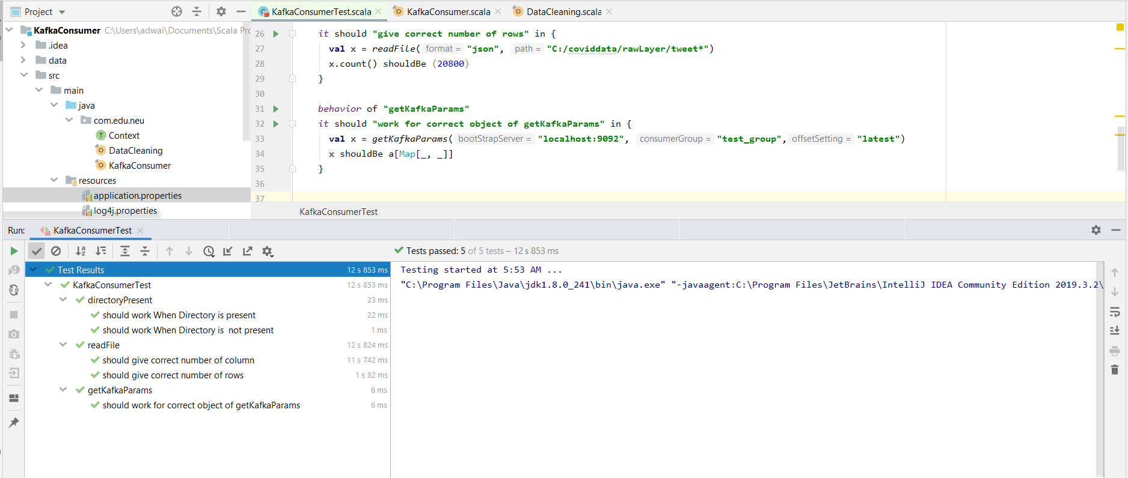
Unit Test

Slide 9
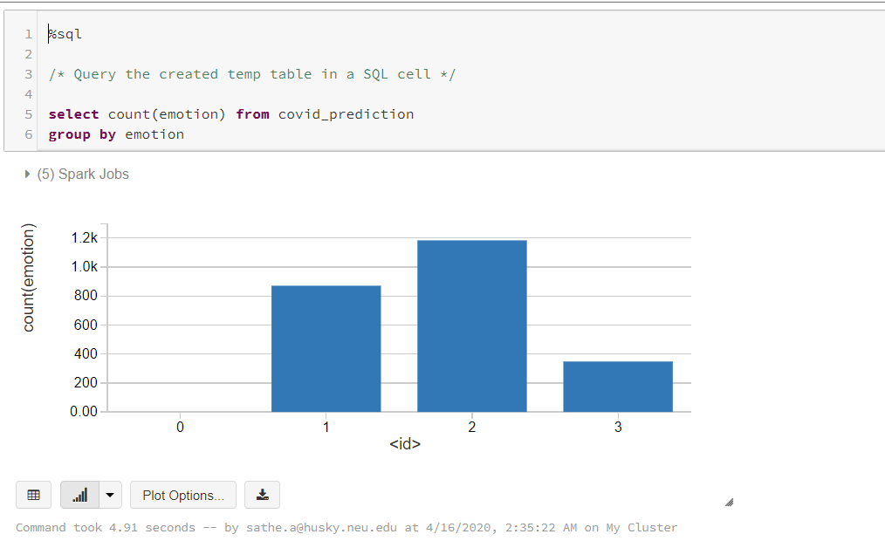
Visualization

Slide 10
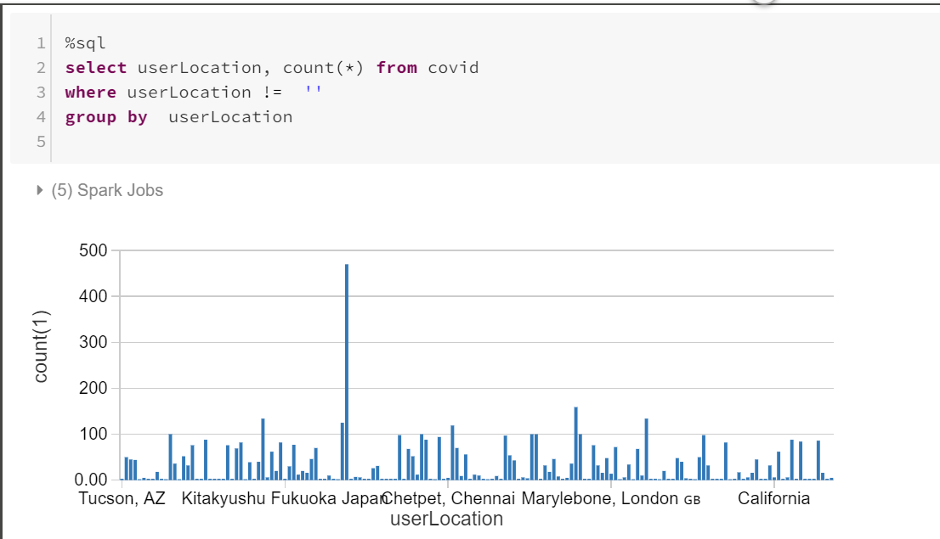
Visualization

Slide 11
GitHub
https://github.com/CSYE7200-scala-final-project

Slide 12
THANKS !

